Slide 1
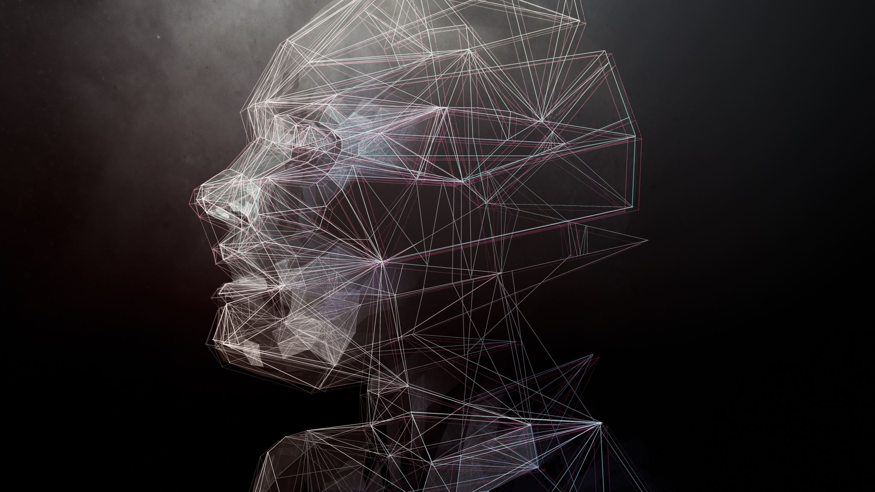
The Lazy Cloud Application
CSE – 5333 - Cloud Computing
Jairaj Gogula – 1002032371

Slide 2
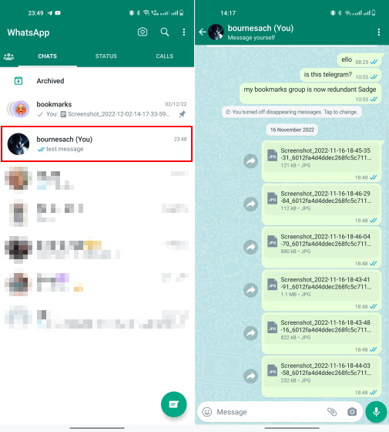
Problem
Imagine you just came back from a trip
You have loads of photos.
We need to send photos to others.
It is time consuming process and boring to do.
We might miss photos.
Going through marriage photos(photos at scale) is a PAIN

Slide 3

Solution
A cloud solution that does this for us and makes the task easier for her.

Slide 4

How it works?
The Admin bulk uploads to a bucket in GCP
User wants only their photos !!!!
The user upload his FACE
DeepFace API matches all photos
We can then download all these photos.

Slide 5
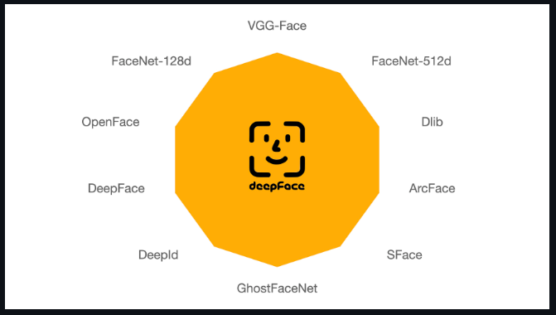




Technologies & Packages
Opencv2
Google Cloud Vision
Google Cloud Storage
DeepFace

Slide 6

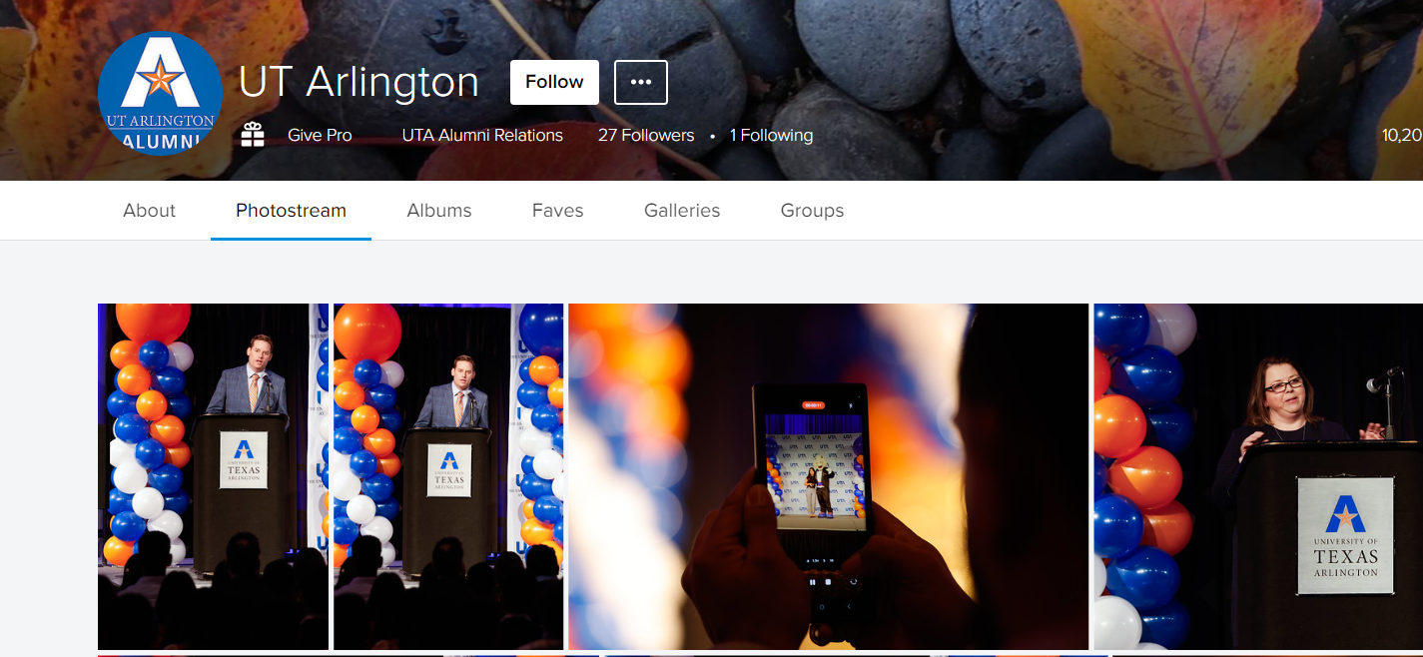
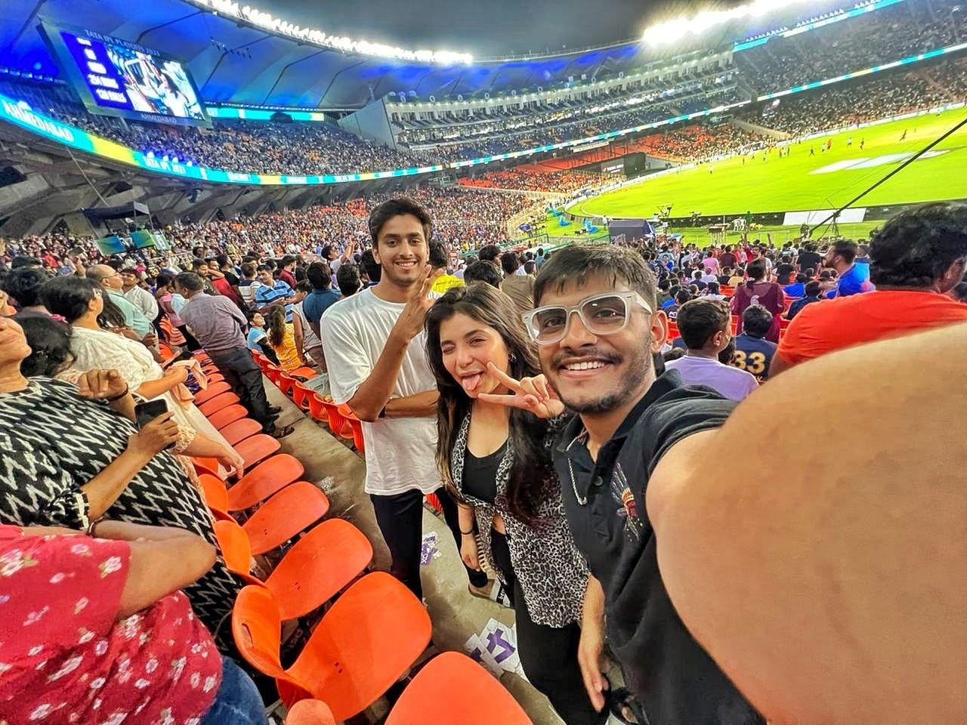
Use Cases

Slide 7
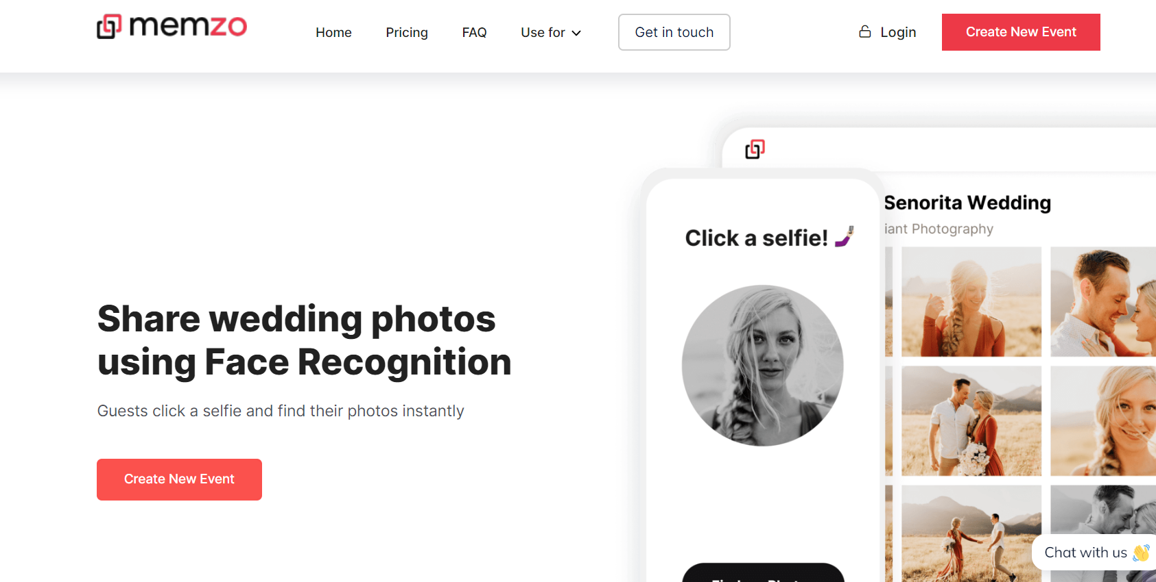

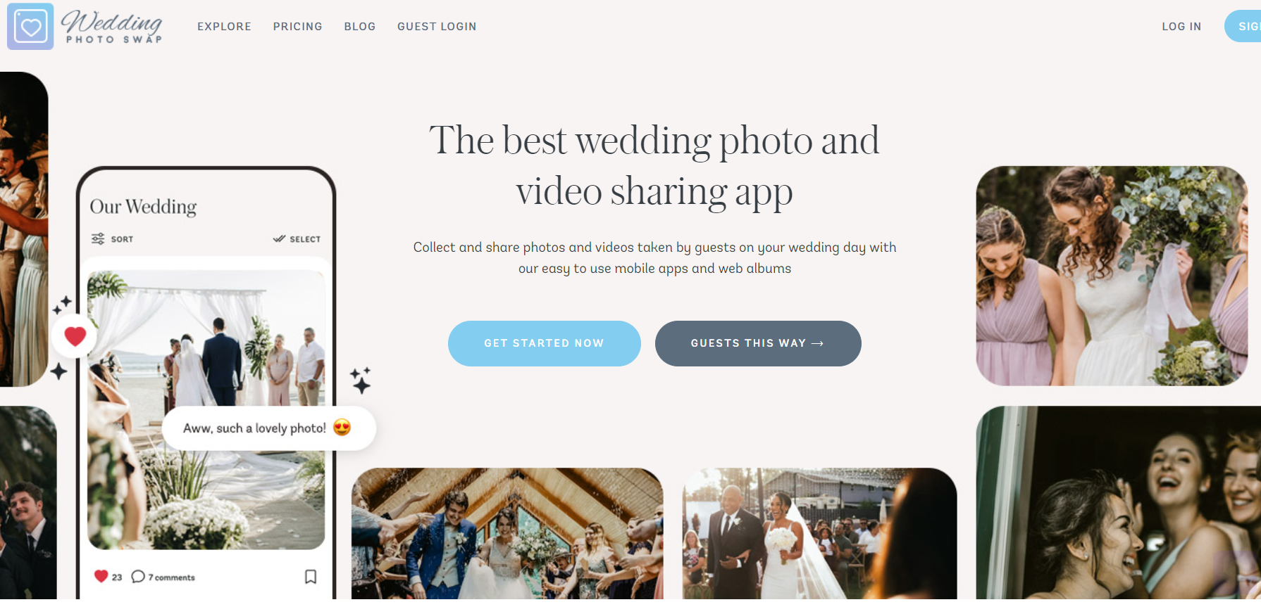
Comparision
There are several application out there that provide this service for a monetary value.
Memzo is using S3 bucket and face recognition from Amazon.

Slide 8

Demo

